Slide 1
Energy-Efficient Wireless Communication
By Yardley Francois
Notes:
Hello everyone my name is Yardley Francois, lets jump right into it

Slide 2
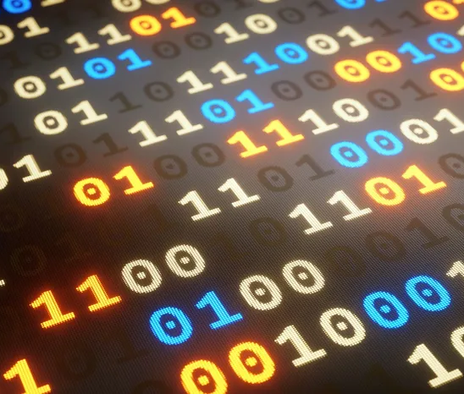
What does that all mean?
What does energy Efficient mean?
The ability to perform a give task using the least energy possible
Notes:
Energy efficient doesn’t directly relate to just technology put how we accomplish our everyday task.

Slide 3
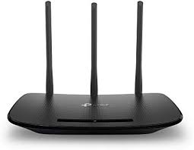
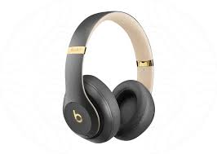
What does that all mean?
What is your definition of Wireless?
Bluetooth
Wi-fi
Hot-Spot
Notes:
We all use wireless devices
From using headphones at the gym, surfing the web or shopping on wi-fi network at home or school, if there is no wi-fi we hop on to a hotspot network

Slide 4
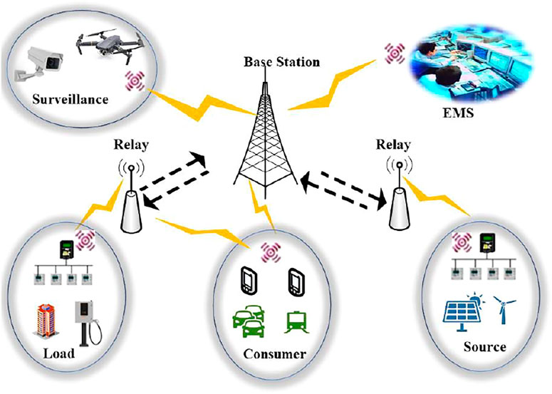
Communication
The key Component to efficient wireless systems
Notes:
All wireless devices communicate to one another in a specific standard, the faster the communication the fast the connection. Communication isn’t just a physical thing all devices have a standard that allows them to communicate to one another that what pairing process is.

Slide 5
Energy Efficient wireless communication
Energy Efficient wireless communication has revolutionized the world in some many ways.
Personal Life
Work Force
Medical field
Notes:
Wireless communication has made our lives extremely efficient allowing use to communication wireless through our cell phones
allowing use to work remote while sitting in the comfort of our homes
Even the major advancements in the medical field ext. respirator's, heart monitors

Slide 6
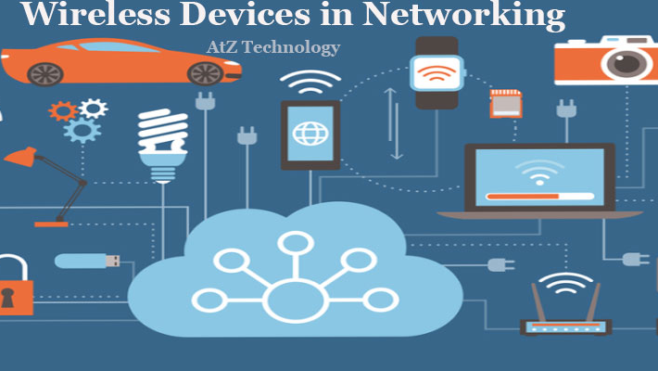
Personal Life | Medical Field | Work force
Cellphones | Pacemakers | Remote Access
Laptops | Insulin Pump | WMAN
Automatic Starters | robotic prosthetic
Notes:
These are a couple wireless devices that have made our lives more efficient.

Slide 7
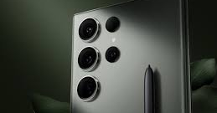

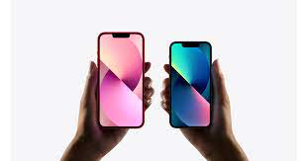
Cellphones
Cellphones are the most widely used wireless communication devices.
Not just for person-to-person communication, most cellphones operate with AI assistance. Make wireless shopping a breeze.
Notes:
Our cell phones do everything for us, there’s used to be a saying that we can’t leave our house with out our wallet now our cell phone is our wallet.

Slide 8
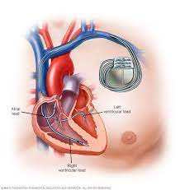
Pacemaker
A device that is controlled though wireless signals to keep your heart at a steady pace
Notes:
The medical field has made major improvements due to the advancements in the wireless communication, from pacemakers to sending medical information from one doctor to another.

Slide 9
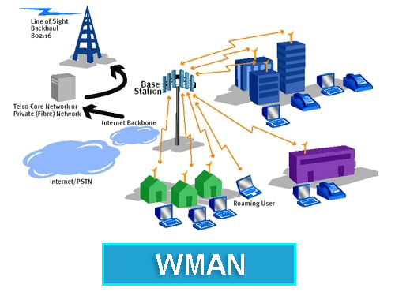
WMAN
Wireless Metropolitan Area Network
You can can conduct any form of business wirelessly because of Wi-fi
Notes:
With wireless communication now allows you to sit in a park and conduct work operations via laptop or

Slide 10
Conclusion
Being energy-efficient can be apply in a physical aspect as well, being able to complete a given task with the least energy.
Being able to talk to some Via webcam while the receiver is in another country
Insulin pump you no longer need to inject/poke your self with a needle anymore.
Robotic prosthetic’s all we do is think it and the prosthetic moves.
All wireless devices, has made a major impact on make everybody day to day task simpler and extremely easier to complete.
Notes:
In conclusion while wireless communication devices become more energy efficient, it tends to make our lives much easier. From making it is to communicate with family over seas. Having doctors monitor your heartbeat while running on a treadmill or have your brain signals to a protistic device. With wireless devices we can work anywhere in the world thank you

Slide 11
Energy-Efficient Wireless Communication
Q&A

